Slide 1
Auto Reminder Workflow Architecture
IMRAN BASHA

Slide 2
Agenda
Existing Autoreminder Cron workflow
Issues in Cron workflow
Autoreminder SWF Workflow Architecture
Workflow setup
Monitoring
Demo

Slide 3
Existing Cron workflow

Slide 4
Existing Cron workflow - Issues
Lost schedules
Co-ordination among Admin host and Cron Hosts
Reliability
Scalability
Failure Handling
Pre assigning CompanyID’s to JVM’s

Slide 5
Auto Reminder SWF Workflow

Slide 6

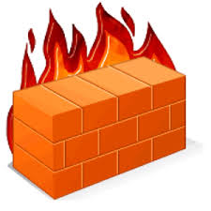


Auto Reminder SWF Workflow Architecture
Activity Workers
Get Task
Send Reminder Worker
Amazon
SWF
Long Poll
SWF Console / Workflow Starter
Starts execution of Cron Workflow
Send Reminder Tasks
Start Workflow Execution
Company List Tasks
Get Task
Send Reminder Worker
Long Poll
Decision Tasks
Execution History
Input Data
Timer Started
Timer Fired
Company List Completed
Reminder Completed
AutoReminder Workflow Worker
Get Task
Long Poll
Get Task
CompanyList Worker
Long Poll

Slide 7
Infrastructure Architecture
Send Reminder Activity Worker
Running in Cloud
“RunSendAutoReminder”
AutoReminder Workflow Worker
Cron Host
Send Reminder Activity Worker
“RunSendAutoReminder”
CompanyList Activity Worker
Cron Host
:
:
Amazon
SWF
Send Reminder Activity Worker
“RunSendAutoReminder”
QBO “GetCompaniesList”
Cron Host
Admin Host
Process boundary

Slide 8
Autoreminder SWF setup
AutoReminder Workflow Worker
Send Reminder Activity Worker
Send Reminder Activity Worker
Send Reminder Activity Worker
Send Reminder Activity Worker
Send Reminder Activity Worker
Send Reminder Activity Worker
CompanyList Activity Worker
Cron Host
Cron Host
Cron Host
Workflow Starter
Admin Host
Setup.sh

Slide 9
Autoreminder SWF setup
AutoReminder Workflow Worker
Send Reminder Activity Worker
Send Reminder Activity Worker
Send Reminder Activity Worker
Send Reminder Activity Worker
Send Reminder Activity Worker
Send Reminder Activity Worker
CompanyList Activity Worker
Cron Host
Cron Host
Cron Host
Workflow Starter
Admin Host
Setup.sh

Slide 10
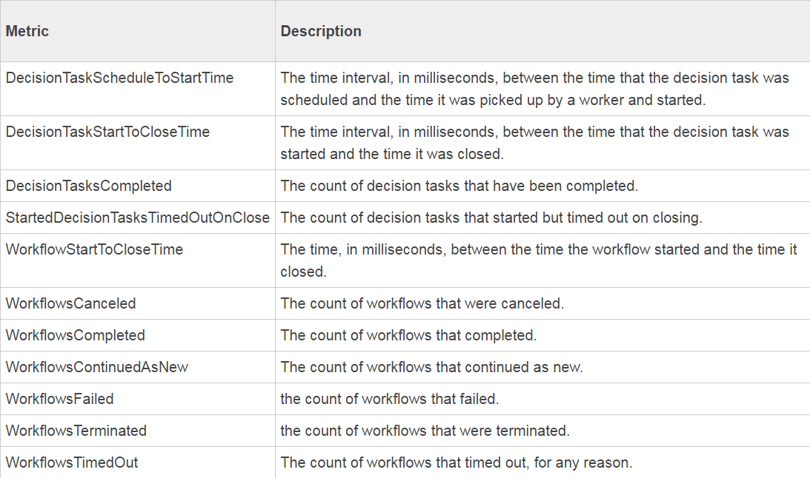
Monitoring
Amazon CloudWatch for analytics on SWF application
Splunk based alerts for component/process level failures
Admin dashboard to restart worker
Notes:
Amazon CloudWatch is a monitoring service for AWS cloud resources and the applications you run on AWS. You can use Amazon CloudWatch to collect and track metrics, collect and monitor log files, set alarms, and automatically react to changes in your AWS resources.

Slide 11
AWS SWF Features
High scalable Distributed application
Periodic Asynchronous workflow execution
Retry for failed activities
Reliable execution
Results wont be lost
Notes:
Amazon SWF has two key features that make it easy to scale a workflow application to handle the current load
1. A complete workflow execution history, which allows you to implement a stateless application.
2. Task scheduling that is loosely coupled to task execution, which makes it easy to scale your application to meet current demands.

Slide 12
DEMO
Notes:
Amazon SWF has two key features that make it easy to scale a workflow application to handle the current load
1. A complete workflow execution history, which allows you to implement a stateless application.
2. Task scheduling that is loosely coupled to task execution, which makes it easy to scale your application to meet current demands.

